Slide 2
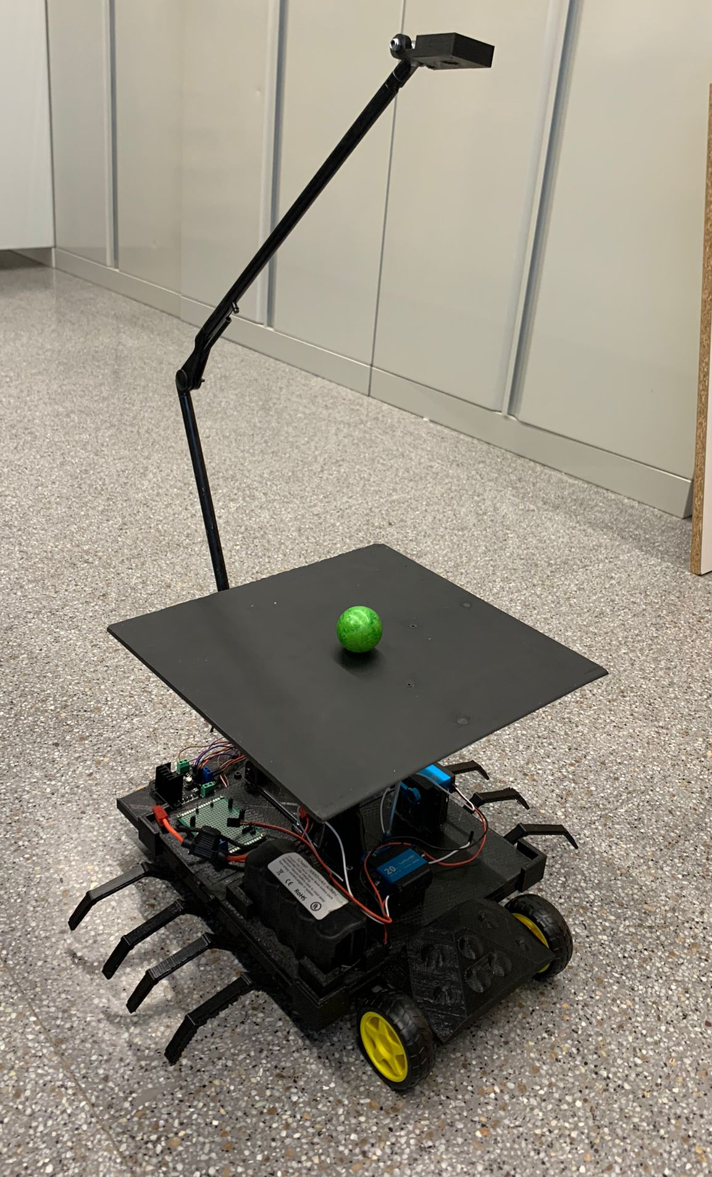
Introduction
This is a balance board that is equipped with legs/wheels:

Slide 3
Objectives
Main function
The objective is to create a balancing plate using different mechanical, electrical and programming components. The goal is achieved when it can keep an object on a plate from falling.
Secondary function
Making the balancing plate mobile to increase the usability of the product. The movement will be created with two wheels attached to motors.

Slide 4




Team Organization
Isaac
Project Manager
Aïda
Electronics
David
Mechanics
Hortense
Programming

Slide 5
Team Organization & Management tool
https://github.com/Integrated-Project-2-2023-UVic-UCC/balance-board

Slide 6
In the mechanical domain:

Slide 7
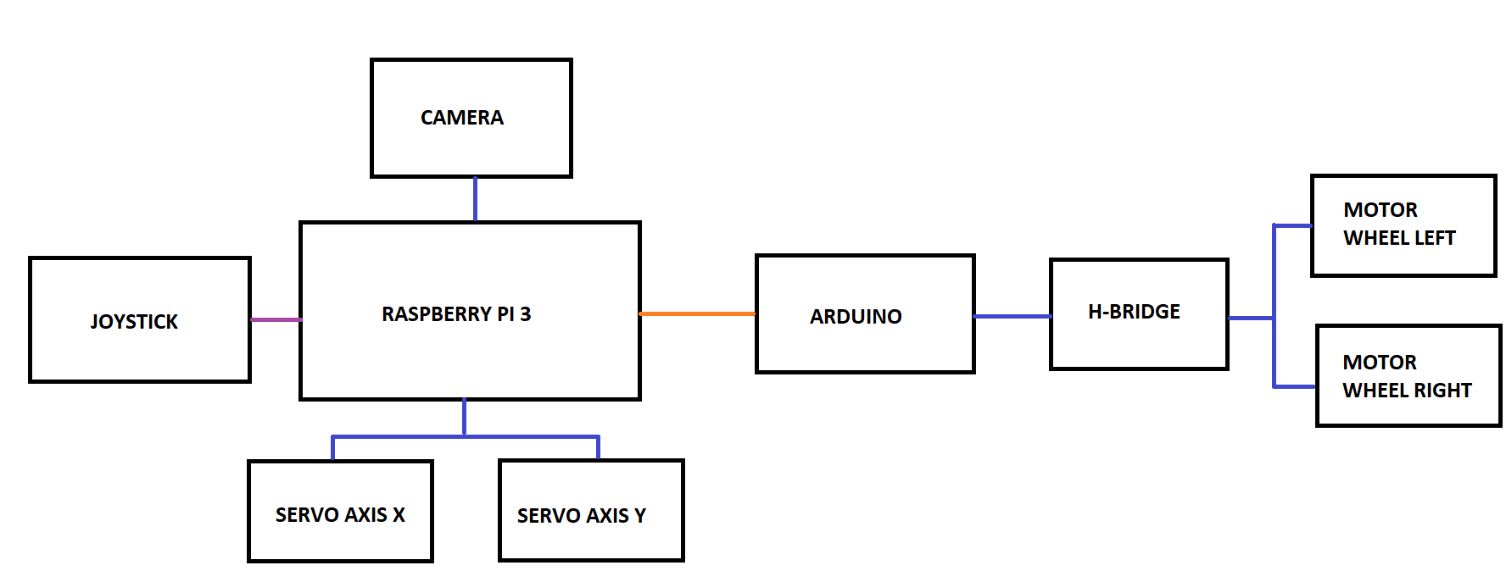
In the Electrical/Electronics domain:

Slide 8
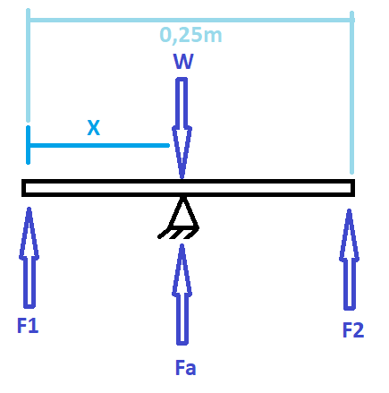
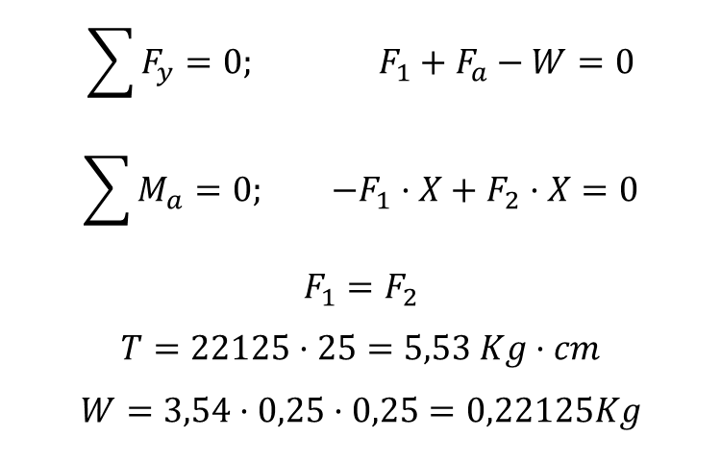
In the Electrical/Electronics domain:
$$\sum{F_{y}}=0; F_{1}+F_{a}−W=0$$
$$\sum{M_{a}}=0; {−F}_{1}·X+F_{2}·X=0$$
$$F_{1}=F_{2}$$
$$T=22125·25=5,53 Kg·cm$$
$$W=3,54·0,25·0,25=0,22125Kg$$

Slide 9
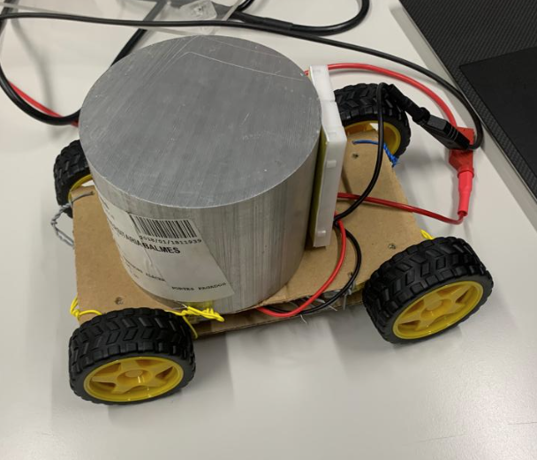
In the Electrical/Electronics domain:
To choose the DC motors for the wheels we tested with 5 Kg.

Slide 10
In the programming domain:

Slide 11
Budget:
Budget of materials
MATERIAL PRICE
PRICE | QUANTITY | MATERIAL
59,45 € | 1 | RASPBERRY PI 3
31,70 € | 1 | RASPBERRY PI 3 CAMERA
6,99 € | 1 | SD CARD for Raspberry PI 3
27,54 € | 1 | CARDAN
16,88 € | 1 | DC Motors
4,82 € | 1 | Metraquilat 250x250mm
43,18 € | 2 | Servos base
7,33 € | 1 | Arduino nano
50,00 € | 1 | Others
247,89 €

Slide 12
Budget:
Hours and effort of team members in the project
DEVELOPMENT WORK
PRICE | HOURS | PERSON - FUNCTION | PRICE FUNCTION
4500 | 100 | Hortense Utuje - Software development | 45
4500 | 100 | David Pfaffenrod - Technical engineer | 45
4600 | 100 | Isaac Lenin Acevedo Bau - Product owner | 46
4500 | 100 | Aïda Calero Chicharro - Technical engineer | 45
18.100,00 €

Slide 13
Budget:
Budget of the project
With the material and the development work the final price to development this project: 18.347,89€
If this product is going to sold in a store, as the development is already done, the final price is 397,89€, only the material and the assembly of the technician would be charged.

Slide 14
Contents
Objectives and motivation of the project
Which are the objectives, challenges and novelties of your project
Specifications for the device you are designing
Main characteristics of the project, function and design (dimensions, weight, components, power supply, sensors, motors, etc.). Here it would be interesting to include the block diagrams of the subsystems that comprise your project.
Mechanical/Electronic calculations and validation
What has been calculated, how it has been validated (i.e., simulations) and the design choices taken from the results. Highlight the most challenging parts of the project or the design choices ones you are more proud of. Please notice that there is no need to show the calculations step by step, for that we already have the documentation.
14

Slide 15
Contents
Demonstrators:
Presentation the project split in subsystems:
- Explanation of each subsystem
- Demonstrator: show that each subsystem works.
Integration of the subsystems
Explanation of how all subsystems are integrated
Demonstrator: show that the integration will work.
Working prototype at current state.
You do not need to show the code, but use block diagrams instead
Budget:
Budget of materials
Hours and effort of team members in the project
Budget of the project
15

Slide 16
Website
URL with the instructables (https://www.instructables.com/) website of the project
Your website must include enough information to fully replicate your project, in the similar manner than other “Instructables” or “Do It Yourself (DIY)” repositories.
16

Slide 17
References
List of 3-5 references
1 slide
Defined according to:
https://www.uvic.cat/biblioteca/guia-elaborar-citacions-bibliografiques
17

